Slide 1


By: Saul Agustin Hernandez Palacios
Date: 14/05/2024

Slide 2

Outline
Executive Summary
Introduction
Methodology
Results
Conclusion
Appendix

Slide 3
Executive Summary
Summary of methodologies
Summary of all results

Slide 4
Introduction
Project background and context
Problems you want to find answers

Slide 5

Section 1

Slide 6
Methodology
Executive Summary
Data collection methodology:
The data was collected for this analysis was collected using the records in Wikipedia with the name: “List of Falcon 9 and Falcon Heavy launches” (see appendix for reference).
Perform data wrangling Removing data that could alter the correct interpretation of the data.
Perform exploratory data analysis (EDA) using visualization and SQL
Perform interactive visual analytics using Folium and Plotly Dash
Perform predictive analysis using classification models
To obtain the best results, we used Machine using ‘GridSearchCV’ using methods like: Linear regression, Support Vector Machine, Tree classification and K-Nearest Neighbor

Slide 7

Data Collection
The data was selected from “List of Falcon 9 and Heavy Launches”, from which we selected a static URL based on the update on 9th of June 2021 to prevent changes or discrepancies on the findings of this project.
More details in following slide*

Slide 8
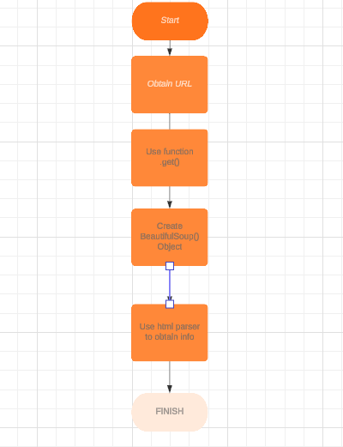
Data Collection – SpaceX API
We will use the BeeautifulSoup to get the information as html and later create a DataFrame using ‘Pandas’ to work with the data.
If needed, original code used for this part of the project can be accessed through the following source:
https://github.com/SleepySlowpoke/DS_Capstone/blob/main/jupyter-labs-webscraping.ipynb

Slide 9
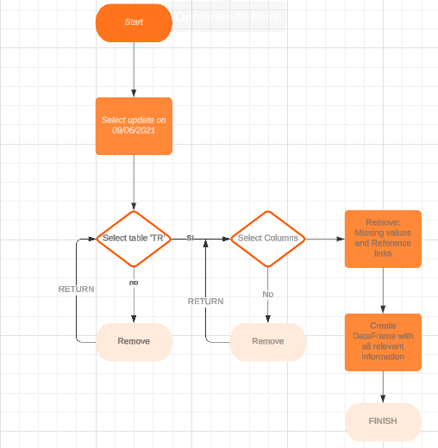
Data Collection - Scraping
To Scrap unnecessary data we select only the table and remove reference links, missing values and symbols
Scraping process can be accessed through the following link:
https://github.com/SleepySlowpoke/DS_Capstone/blob/main/jupyter-labs-webscraping.ipynb
Place your flowchart of web scraping here

Slide 10
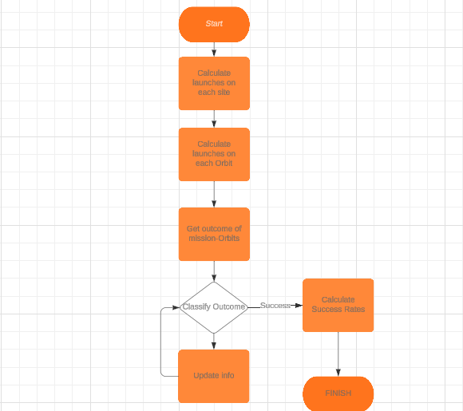
Data Wrangling
For this step: 1. Calculate the number of launches in each site and in each orbit to find any correlations. 2. Get relation of outcome of missions-orbits 3. Classify the outcomes as Success or Failure 4. Determine Success rate
The relevant code can be accessed through the following link:
https://github.com/SleepySlowpoke/DS_Capstone/blob/main/labs-jupyter-spacex-Data%20wrangling.ipynb

Slide 11
EDA with Data Visualization
To see find trends related to the variables in our data, we see the impact of the Payload Mass, Launch Site, Flight Numbers, Orbits within each other and we visualize the yearly trend of successful launches.
Code can be accessed through the following link: https://github.com/SleepySlowpoke/DS_Capstone/blob/main/jupyter-labs-eda-dataviz.ipynb

Slide 12
EDA with SQL
The next step was to visualize information with SQL using sqlMagic doing the following queries:
1. Total payload Mass launched by NASA (CRS) 2. Average Payload mass carried by booster F9 v1.1 3. Last successful landing date for classification ‘Ground-Pad’ 4. List of boosters with successful ‘Drone ship’ and payload mass within 4k-6k 5. Number of successful and failed mission outcomes 6. Booster Versions that carried the maximum payload Mass 7. Months of failed landings in 2015 (including launch site and Booster Ver.) 8. Failed drone ships or success group pad landings from 2010-06-04 to 2017-03-20
Code can be accessed through the following link: https://github.com/SleepySlowpoke/DS_Capstone/blob/main/jupyter-labs-eda-sql-coursera_sqllite.ipynb

Slide 13
Build an Interactive Map with Folium
With the use of Folium, we created multiple maps to see 1. The location and name of the Launch sites 2. Mark both the successful and failures of each of these site 3. Calculate de distance and proximities like coastlines, railroads, cities and highways.
This was done to see a visual representation of the launch sites in a more comprehensive way and to see if there’s any possible variables that affect the launches (for example, proximity of certain structures or places of geological relevance)
Code can be accessed through the following link: https://github.com/SleepySlowpoke/DS_Capstone/blob/main/lab_jupyter_launch_site_location.ipynb

Slide 14
Build a Dashboard with Plotly Dash
To understand data in a more visual way and in a more dynamic way depending on the required limits needed, 2 different interactive graphics were created. 1. A pie chart to see the success of each site
2. The correlation of the sites with both the payload mass and Boosters
These 2 visual aids were created to understand the data obtained and the way it also relates to previous parts within this project. However, doing this analysis with the visualization that the figures provide might help understand the information in a more intuitive way and show patterns more evident.
Code can be accessed through the following link: https://github.com/SleepySlowpoke/DS_Capstone/blob/main/PlotlyDash.py

Slide 15
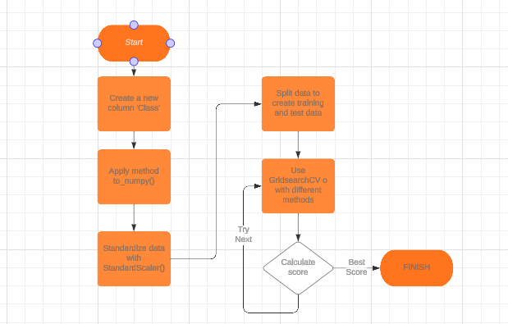
Predictive Analysis (Classification)
After creating a new class to see the success of the flights, we standardize the data, create Testing and Training sets and finally evaluate using different methods.
Code can be accessed through the following link: https://github.com/SleepySlowpoke/DS_Capstone/blob/main/SpaceX_Machine_Learning_Prediction_Part_5.jupyterlite.ipynb

Slide 16
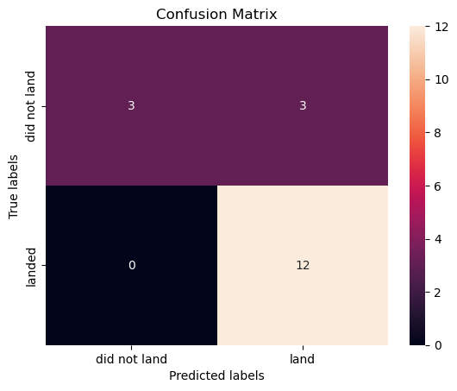
Results (pt.1)
Predictive analysis results

Slide 17
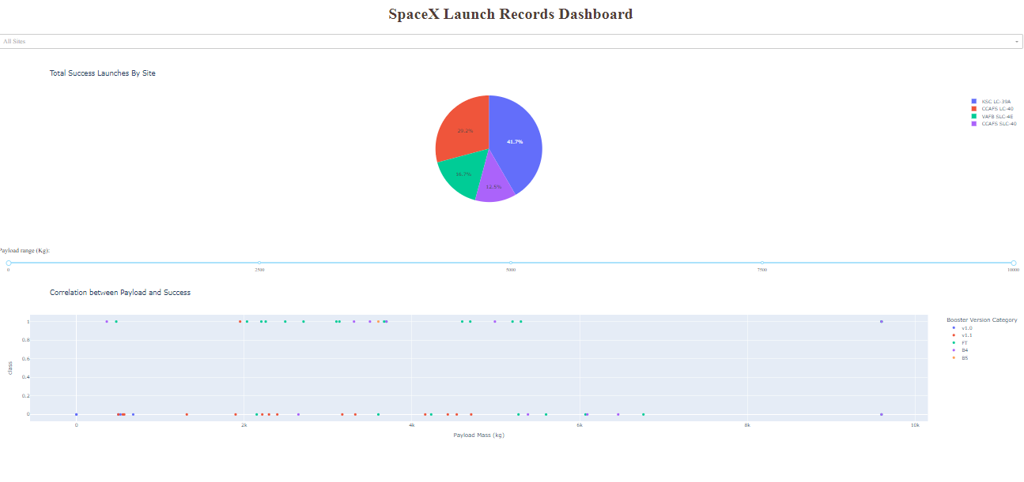
Results(pt.2)
Interactive analytics demo

Slide 18

Section 2

Slide 19
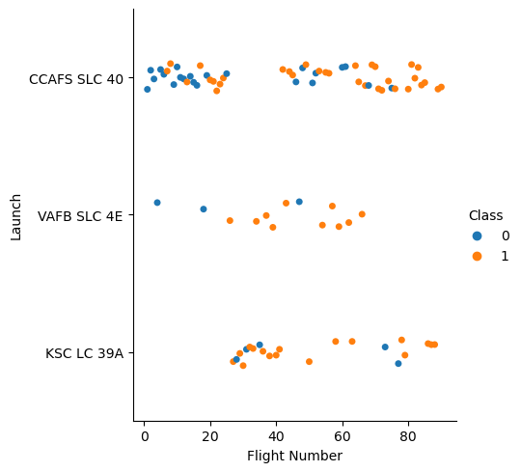
Flight Number vs. Launch Site
In the scatter plot of Flight Number vs. Launch Site we can see that VARFB SLC 4E has a lower number of flight, however the success rate is higher in comparison to CCAFS SLC40.
Similarly KSC LC 39A have a proportionally similar success rate given the higher amount of launches.

Slide 20
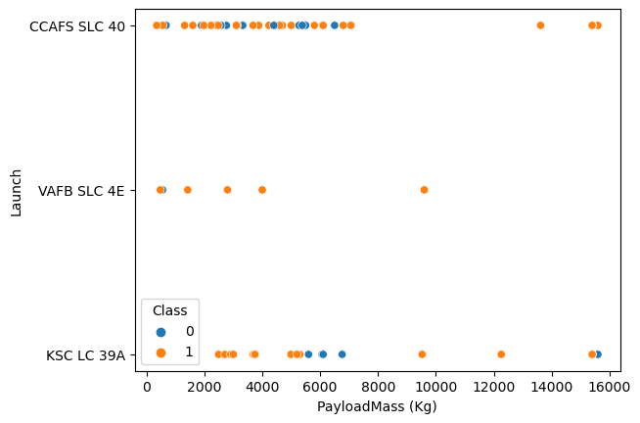
Payload vs. Launch Site
In the scatter plot of Payload vs. Launch Site we can see that ‘CCAFS SLC 40’ have mixed outcomes, however all of the launch sites have a tendency to higher success when the payload mass is higher. On another note, ‘VAFB SLC 4E’ never surpassed the 1TON weight.

Slide 21
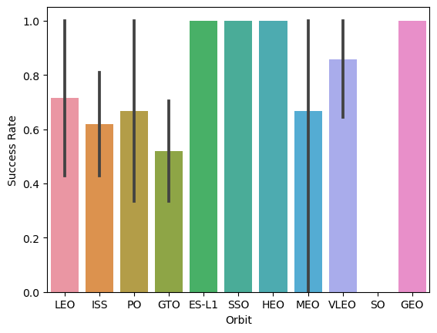
Success Rate vs. Orbit Type
The success rate of each orbit type shows that some of them like GTO have a lower success rate, but: ES-L1, SSO, HEO and GEO have a 100% success rate. From this, we can conclude that using these latter orbits might increase our chances of a successful mission.

Slide 22
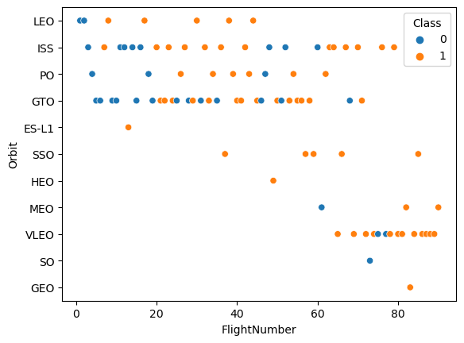
Flight Number vs. Orbit Type
When we use this Flight number vs. Orbit type, we can better understand the previous graphic. For example, ES-L1 has a success rate of 100%, but that information is because there’s only one flight. In fact, when considering the amount of flights it seems like VLEO would be our best bet to have a successful mission.
This shows that we need to understand and consider multiple variables to have a better understanding of our data.

Slide 23
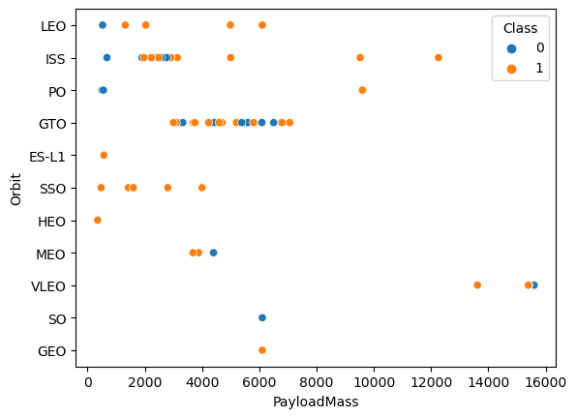
Payload vs. Orbit Type
Similar to the previous slide, as we see the payload vs. orbit type we can see that some of the orbits have been tested in with a limited payload. ES-L1, SSO and HEO all have successful missions but the payload is very small compared to others like ISS or VLEO.
For example, ISS seems to better with higher mass, and LEO follows the same trend when considering only these 2 variables.

Slide 24
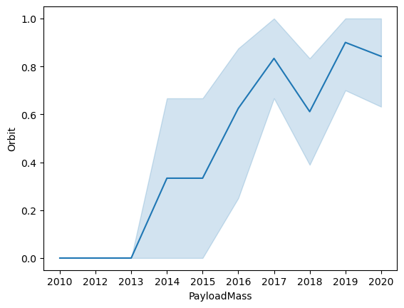
Launch Success Yearly Trend
Finally, when checking t he yearly average success rate we can see that starting in 2013 there’s been a significant raise in success.
And if we do some research we can see that the success is related to the development and improvement of the Falcon versions.

Slide 25
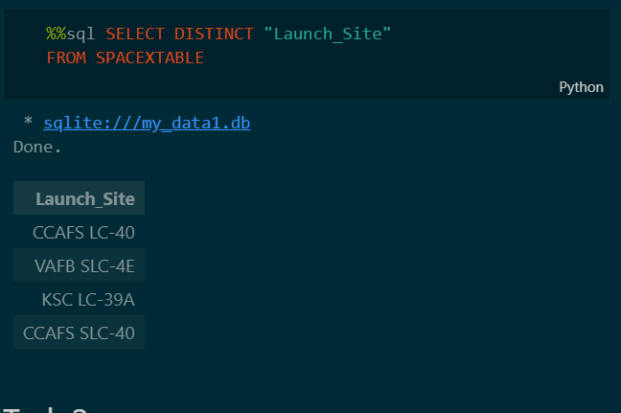
All Launch Site Names
The following are the names of the unique launch sites. This helped us to make the search of information easier instead of looking for each flight individually.

Slide 26
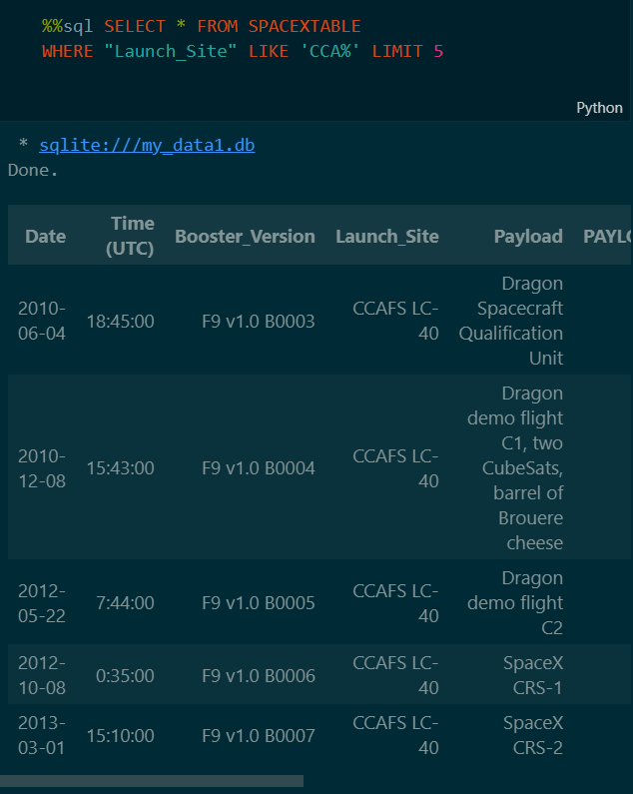
Launch Site Names Begin with 'CCA'
To verify that the information is correct we looked for the first 5 sites that included ‘CCA’ at the beginning.

Slide 27
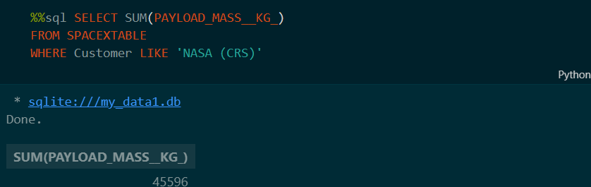
Total Payload Mass
Similarly, to check that all the information is correct and in case it’s needed for further investigation, we calculated the total payload carried by boosters from NASA

Slide 28
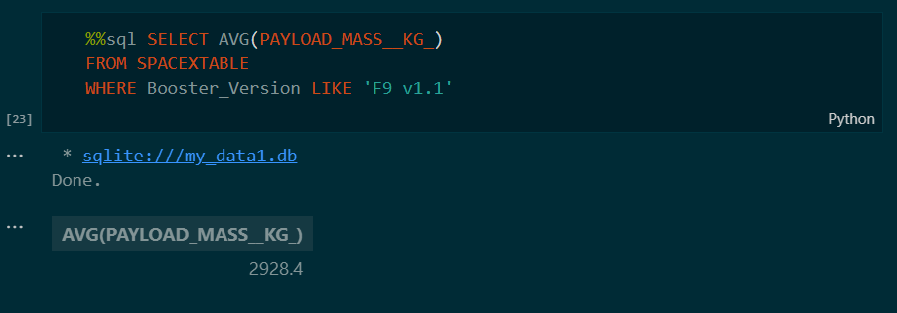
Average Payload Mass by F9 v1.1
To see a specific class we also calculated the average payload mass carried by booster version F9 v1.1

Slide 29
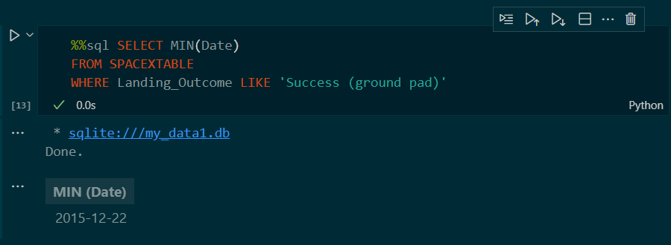
First Successful Ground Landing Date
We can verify that the first successful landing outcome on ground pad was in 2015

Slide 30
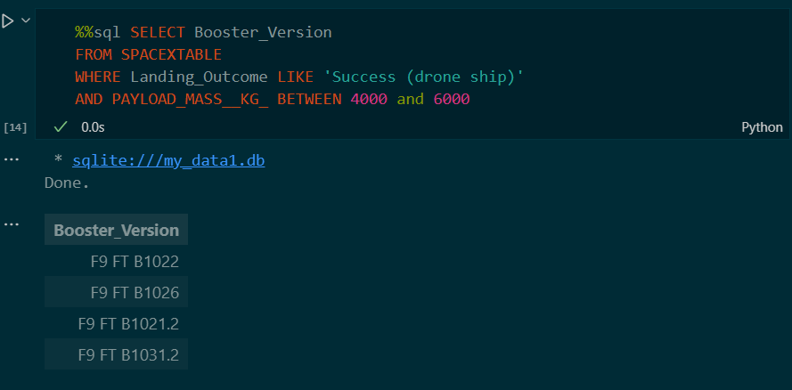
Successful Drone Ship Landing with Payload between 4000 and 6000
Next, we list the names of boosters which have successfully landed on drone ship and had payload mass greater than 4000 but less than 6000

Slide 31
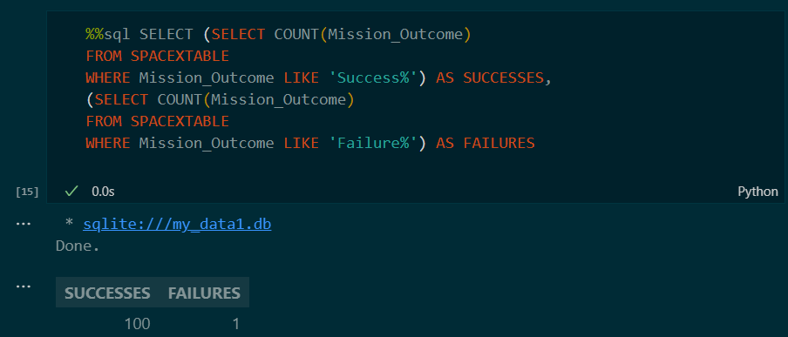
Total Number of Successful and Failure Mission Outcomes
Next we visualize the total number of successful and failure mission outcome

Slide 32
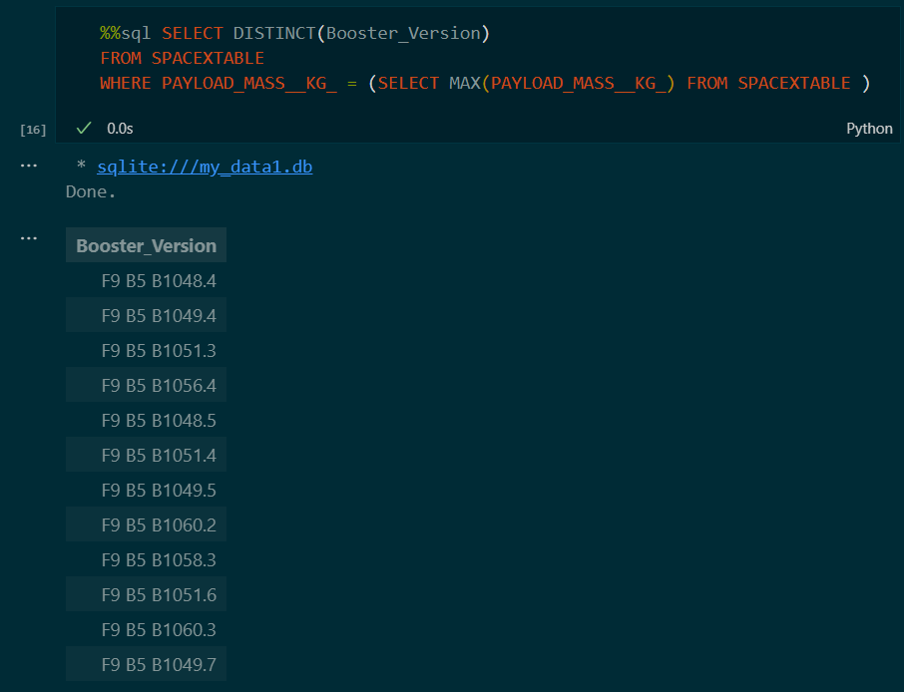
Boosters Carried Maximum Payload
List the names of the booster which have carried the maximum payload mass

Slide 33
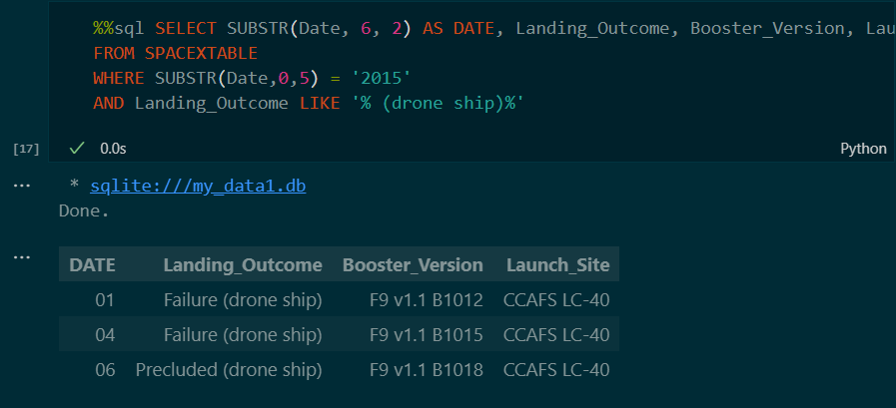
2015 Launch Records
List the failed landings in drone ship, their booster versions, and launch site names for in year 2015

Slide 34
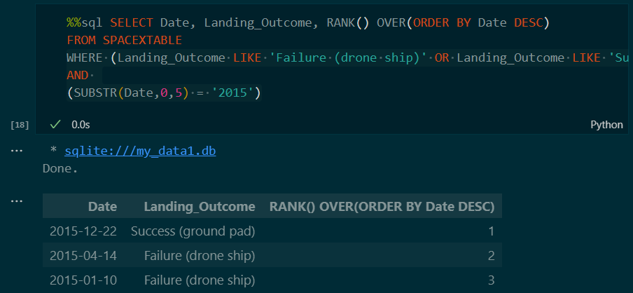
Rank Landing Outcomes Between 2010-06-04 and 2017-03-20
Rank the count of landing outcomes (such as Failure (drone ship) or Success (ground pad)) between the date 2010-06-04 and 2017-03-20, in descending order

Slide 35

Section 3

Slide 36
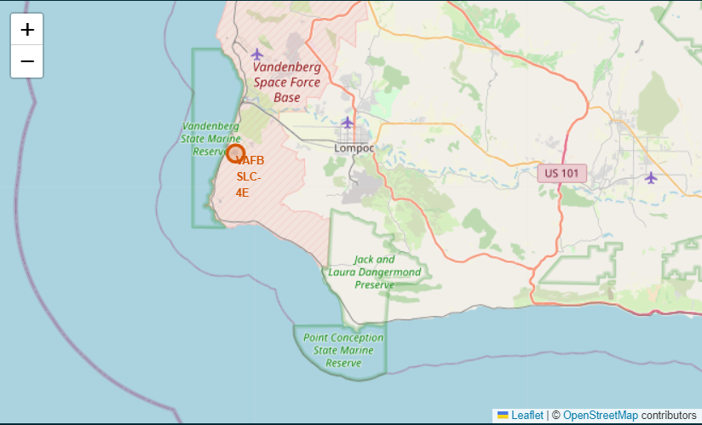
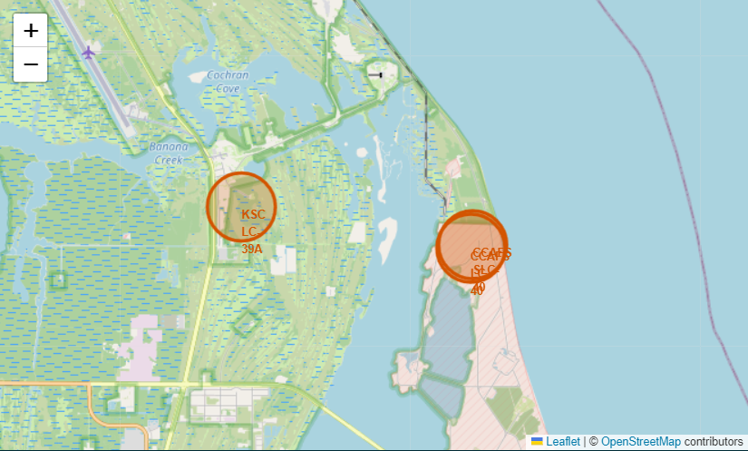
Maps of all launch sites
When using the map we can see that all of them are close to one ocean, which explains why one of the classifications when landing (both failed or succeeded) are Ocean related.

Slide 37
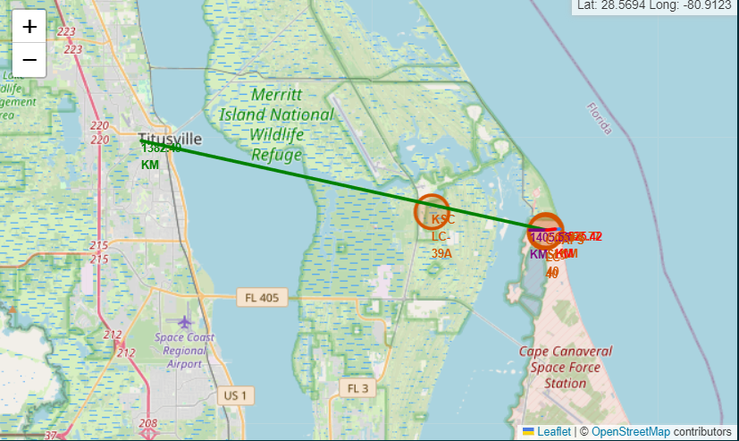
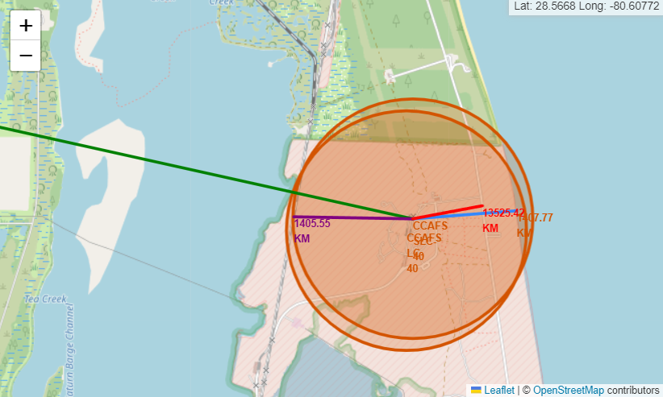
Map of relation to proximities
In the following maps we can see the distance that the site CCAFS SLC-40, located at (29.55706, -95.0156) is relatively close to both railroads and highways but quite distant to the nearst city Titusville at ~1.3k KM

Slide 38

Section 4

Slide 39
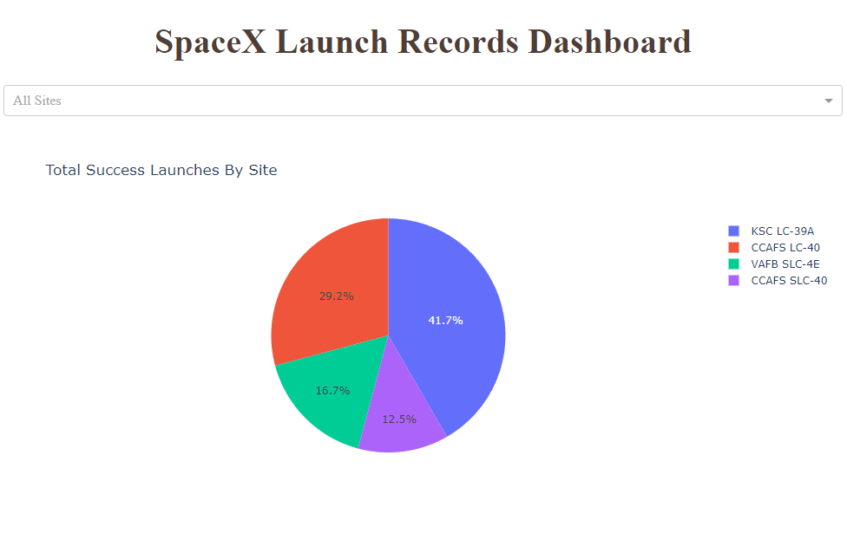
Success rate and Launch site
As we can see in the pie chart, the higher success is at KSC LC-39A, however we need to consider that the amount of flights given each site will affect the numbers.

Slide 40
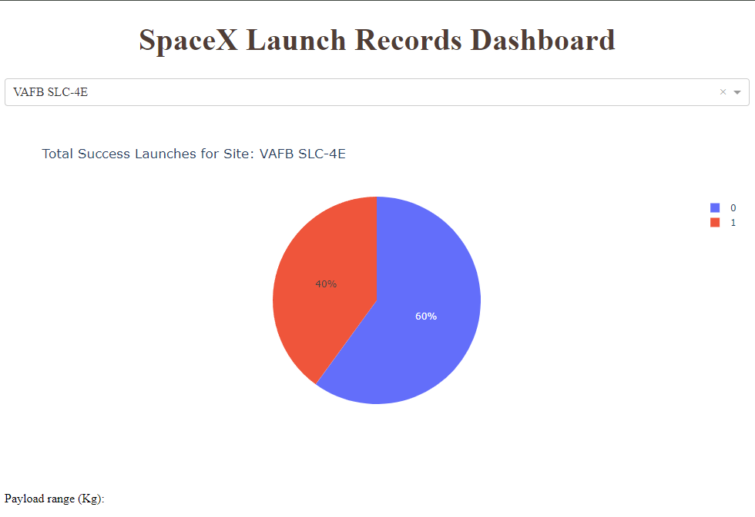
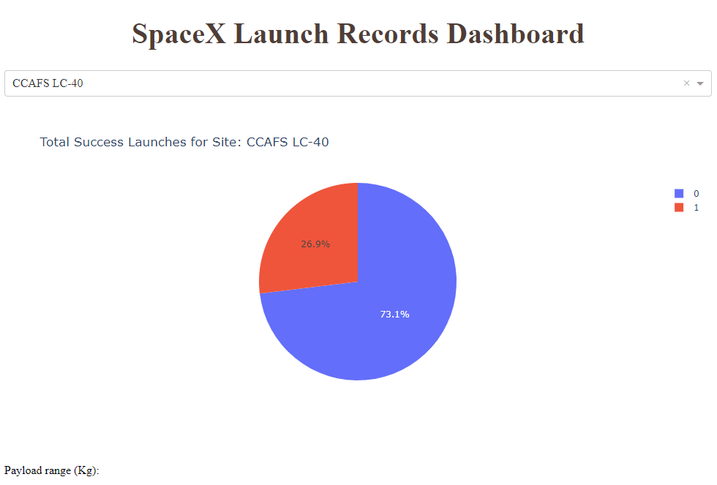
Success rate for sites: CCAFS LC-40 & VAFB SLC -4E

Slide 41
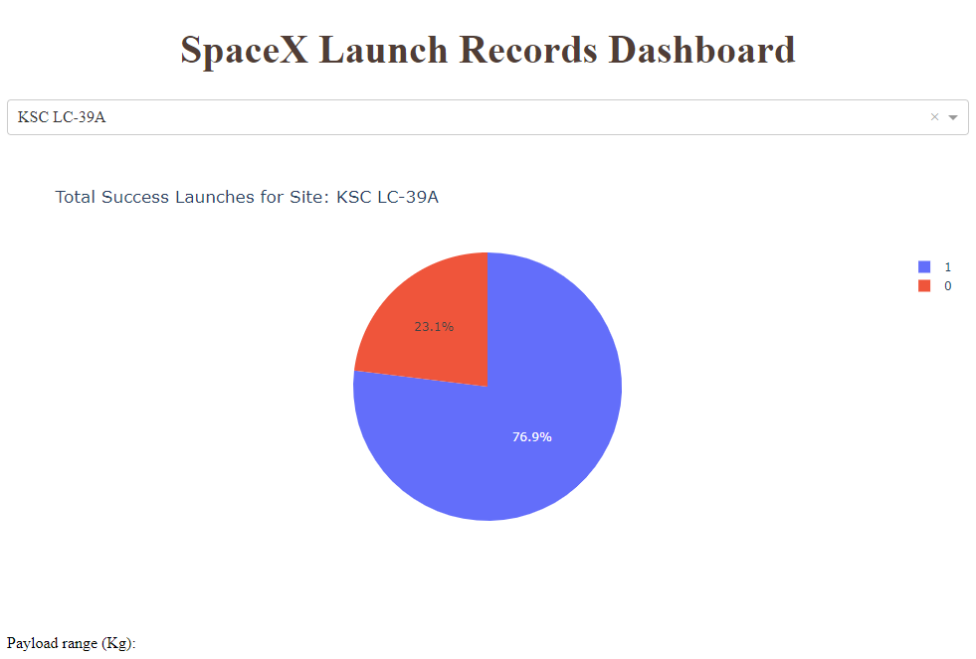
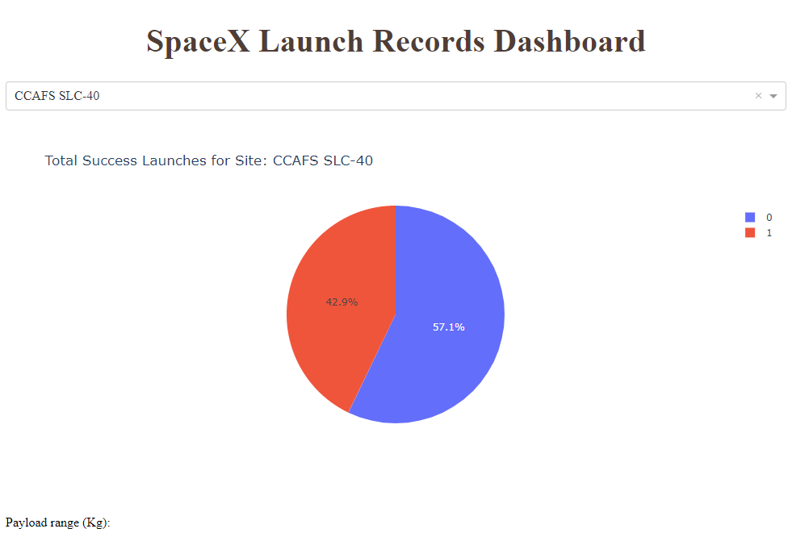
Success rate for sites: KSC LC-39A and CCAFS SLC-40 Note that the site with higher success rate is KSC LC-39A represented in the image on the left

Slide 42
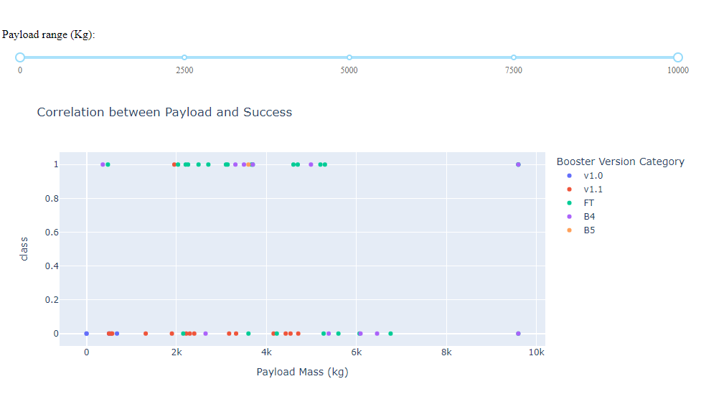
Payload vs. Launch Outcome
First, we can see the correlation of payload and success and how this is also related to the booster version on each flight. From this we can see that the class ‘B4’ have the higher payload mass but with a 50% success rate and the class ‘FT’ has the higher amount of successes (however, keep in mid it also has a high amount of flights)

Slide 43
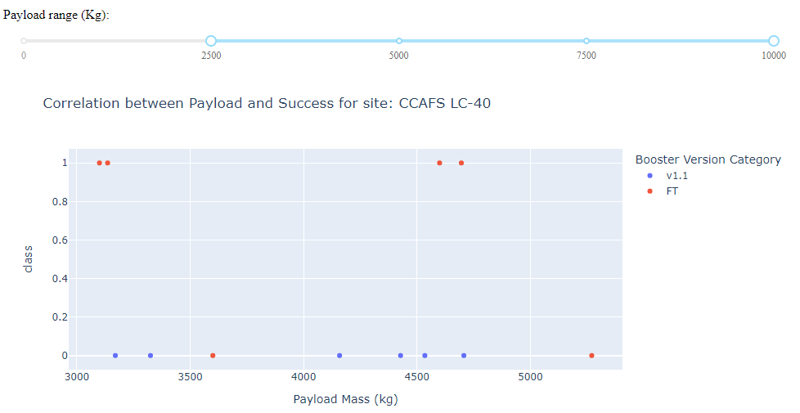
CCAFS LC-40

Slide 44
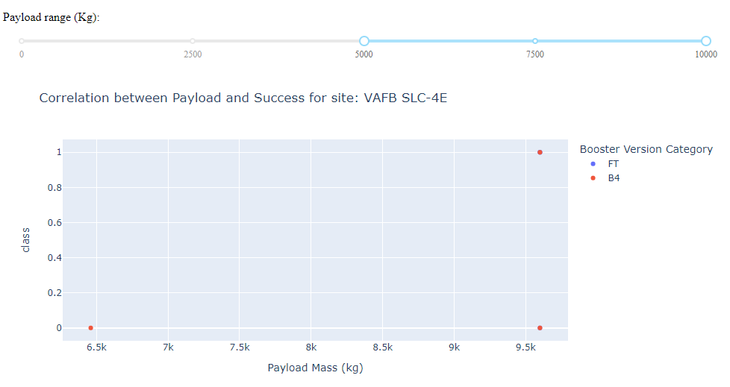
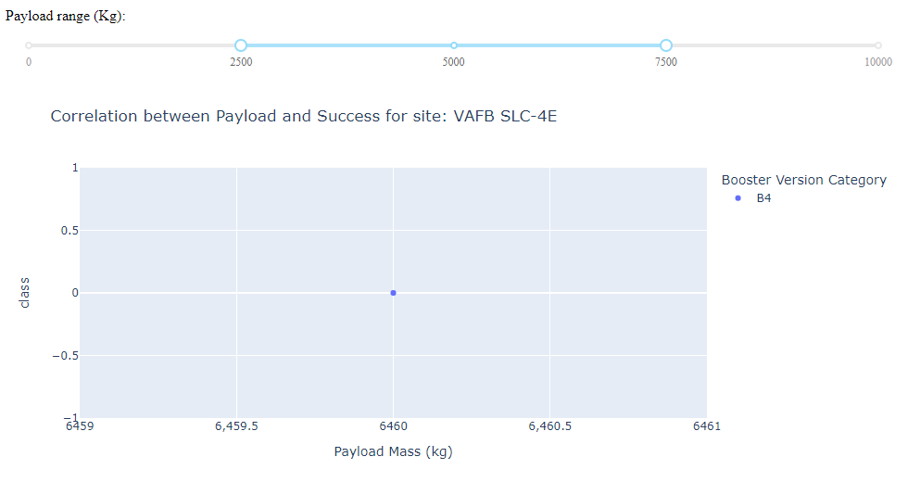
VAFB SLC -4E

Slide 45
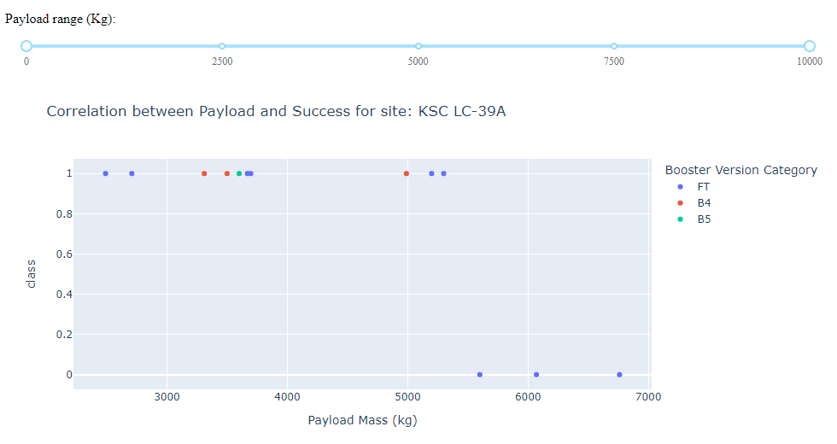
KSC LC-39A

Slide 46
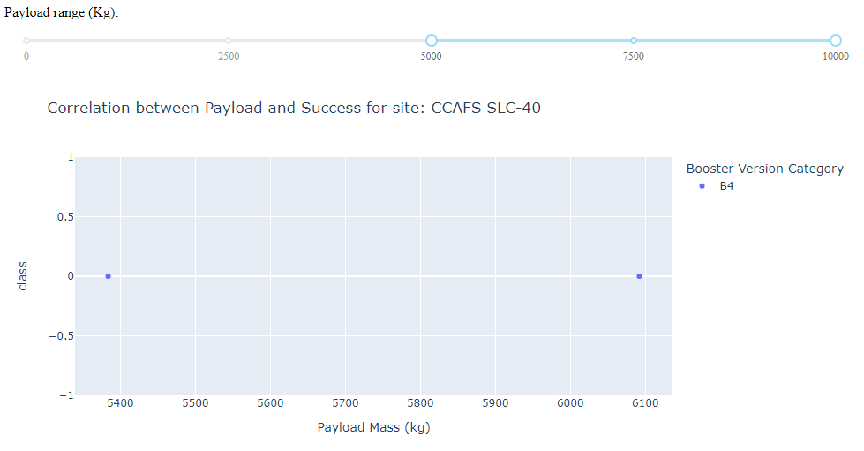
CCAFS SLC-40

Slide 47

Section 5

Slide 48
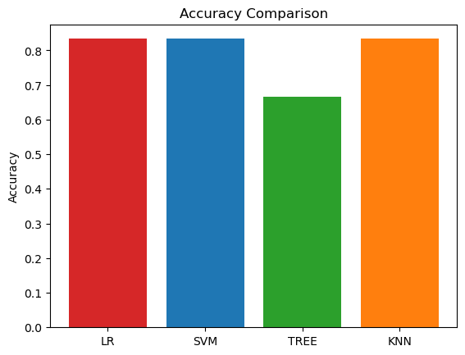
Classification Accuracy
As we can see in the plot: Linear regression(LR), Support vector machine (SVM) and K-nearest neighbors (KNN) have an accuracy of 83.3% but the Decision got a lower accuracy of 66.6%

Slide 49
Confusion Matrix
Here we can see the confusion matrix of the best performing model with an accuracy of 83.3%

Slide 50
Conclusions
Depending on the orbit we want to use for our launch, we would need to consider the payload and booster version to predict a higher possibility of success
With the help of maps done with Folium we now understand how this might affect the ‘Ocean’ classification when landing but there seems to be no relationship with the other surrounding areas near the launch sites.
When visualizing the results of successful landings with a relation of payload and the booster version, we conclude that the optimal option would be: Site KSC LC-39A (without exceeding 5 TONS)
Given the results of the Machine Learning process, we can use 3 different methods with the same level of accuracy to predict the outcome. (for simplicity I would stick with linear regression)

Slide 51
Appendix
Data obtained through:
https://en.wikipedia.org/w/index.php?title=List_of_Falcon_9_and_Falcon_Heavy_launches&oldid=1027686922 https://cf-courses-data.s3.us.cloud-object-storage.appdomain.cloud/IBM-DS0321EN-SkillsNetwork/datasets/API_call_spacex_api.json

Slide 52


